Slide 1


PROJECT :- User Analytics in the Telecommunication Industry
Name:- AMAN SHARMA

Slide 2


Slide 3
INTRODUCTION OF TELECOMMUNICATION INDUSTRY
The telecommunication industry has undergone a transformative evolution over the past few decades, driven by rapid advancements in technology and the proliferation of mobile devices. In this dynamic landscape, user analytics has emerged as a critical tool for telecom companies to understand and cater to their customers' needs effectively. User analytics involves the systematic analysis of customer data, providing insights into user behavior, preferences, and usage patterns.
The importance of user analytics in the telecommunication industry cannot be overstated. By leveraging data analytics, telecom companies can enhance customer satisfaction through personalized services, optimize their marketing strategies to target specific user segments, and improve network performance by anticipating and addressing potential issues. Furthermore, user analytics helps in identifying trends and patterns that can inform strategic business decisions, driving growth and competitiveness in a highly saturated market.

Slide 4
1. Feature Engineering and Size Impact
STEPS IN SUMMARIZING THE DATA PROCESS
Task 1 - User Overview Analysis.
Task 2 - User Engagement Analysis.
Task 3 - Experience Analytics.
Task 4 - Satisfaction Analysis.

Slide 5
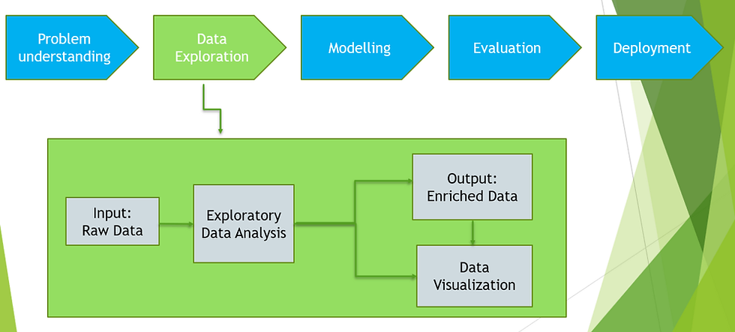
OBJECTIVE

Slide 6
The primary objective of this research is to leverage user analytics to gain comprehensive insights into customer behavior and usage patterns in the telecommunication industry. This will aid telecom companies in optimizing their services and enhancing customer satisfaction. The specific objectives of this study are:
1.Data Collection: The data collection process is a critical component of our research on user analytics in the telecommunication industry, enabling us to gather comprehensive insights into customer behavior and usage patterns. The following subsections detail the sources, types, methods, and tools used in this study.
2.Data Cleaning and Preprocessing: Ensuring the quality of data by handling missing values, removing duplicates, and correcting inconsistencies.
3.Exploratory Data Analysis (EDA): Analyzing the dataset to identify key features, uncover patterns, and visualize trends that impact house prices.
4.Feature Engineering: Creating new features based on domain knowledge and statistical methods to enhance the predictive power of the model.
5.Model Development and Evaluation: Building, training, and evaluating several machine learning models, including linear regression, decision trees, and random forests, to identify the best-performing model.
6.Model Deployment: Developing a user-friendly web application using Streamlit to make the prediction model accessible for user Behaviour estimation.

Slide 7
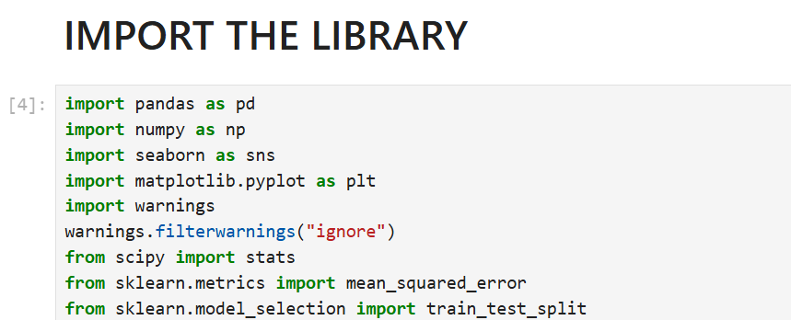
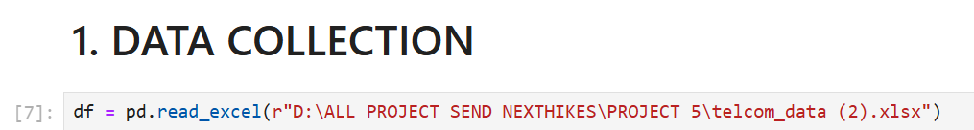
PREPROCESS THE DATA TECHNIQUE
Methods
(i). Loading the Data:
To load the real estate pricing dataset into a Pandas Data Frame, Load the dataset provided in a CSV or Excel format into a Pandas Data Frame to facilitate easy manipulation and analysis. Using Python Pandas Library.

Slide 8
(ii). Cleaning the Data:
Cleaning the data is an essential step in the data analysis process, particularly for User Analytics in the Telecommunication Industry - Overview. It involves preparing the dataset by addressing missing values, removing duplicate entries, and fixing any anomalies or inconsistencies. This ensures that the data is accurate and reliable for further analysis.
Handling Missing Values:
Missing values can occur due to various reasons such as data entry errors or incomplete records. To handle missing values, you can:
Use Isnull() method to identify missing values in the dataset.
Use Fillna() method to replace missing values with appropriate values, such as the mean, median, or mode of the column.
Alternatively, you can use the Dropna() method to remove rows with missing values if they are not critical for your analysis.

Slide 9
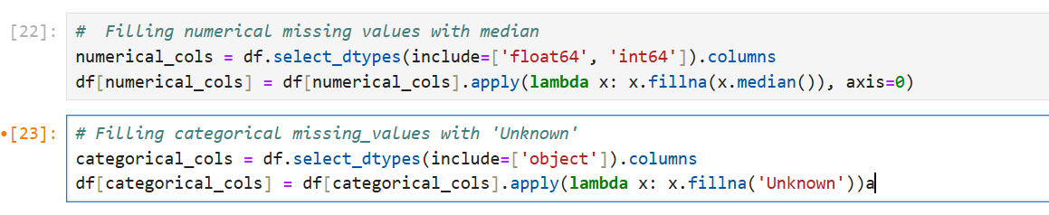
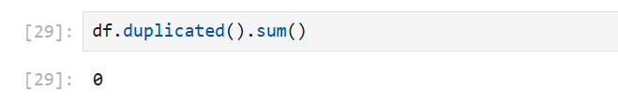
Removing Duplicates:
Duplicate entries can skew the analysis results. To remove duplicates, you can:
Use the duplicated() method to identify duplicate rows in the dataset.
Use the drop_duplicated() method to remove duplicate rows and keep only unique entries

Slide 10

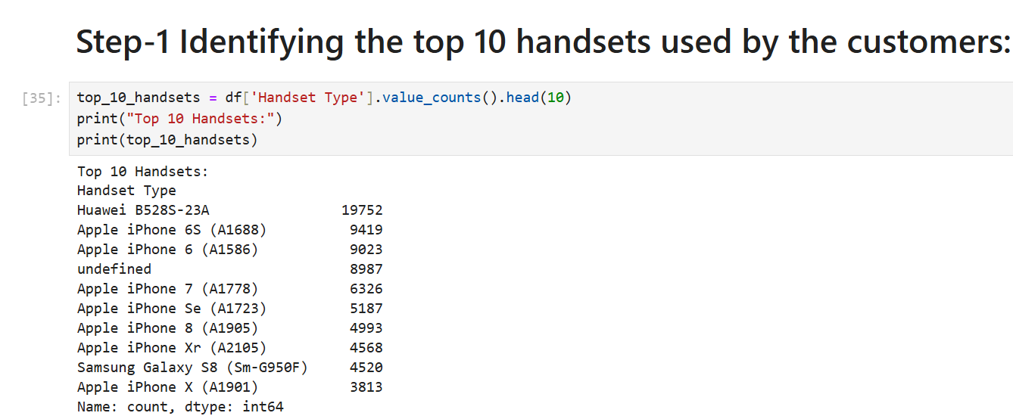
Task 1 - User Overview Analysis
Start by identifying the top 10 handsets used by the customers.

Slide 11
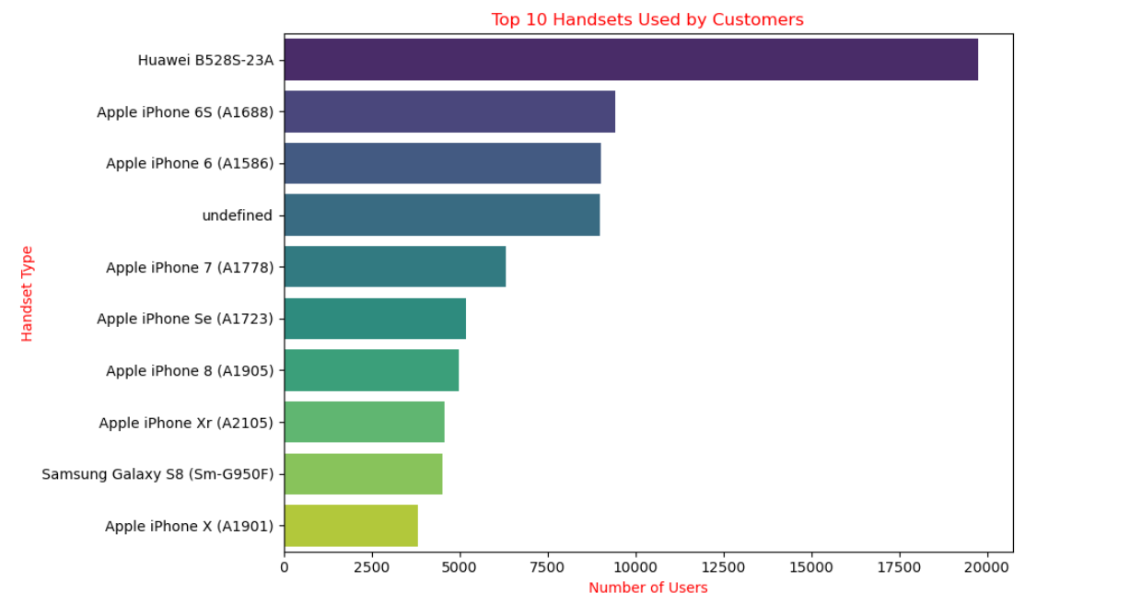
Visualization

Slide 12
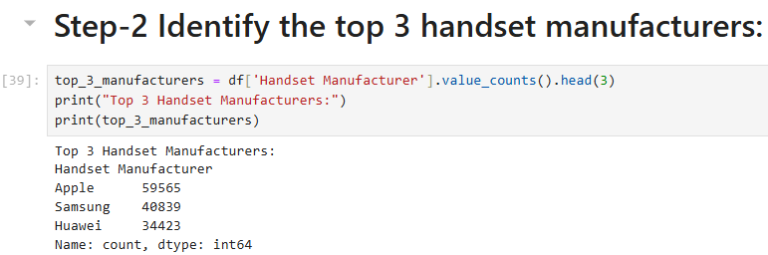
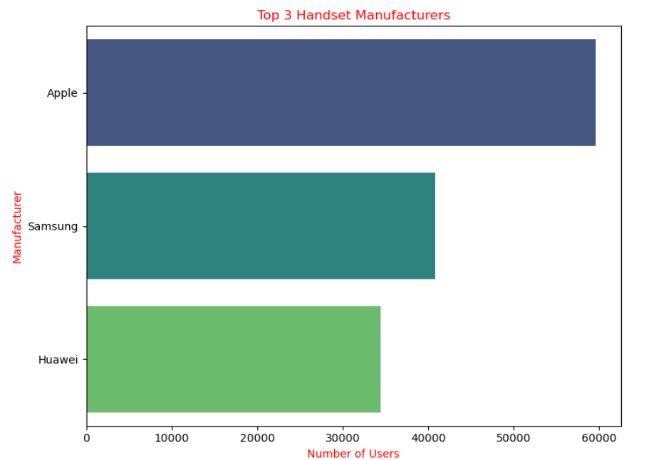
Identify the top_3 Handsets
Visualization

Slide 13
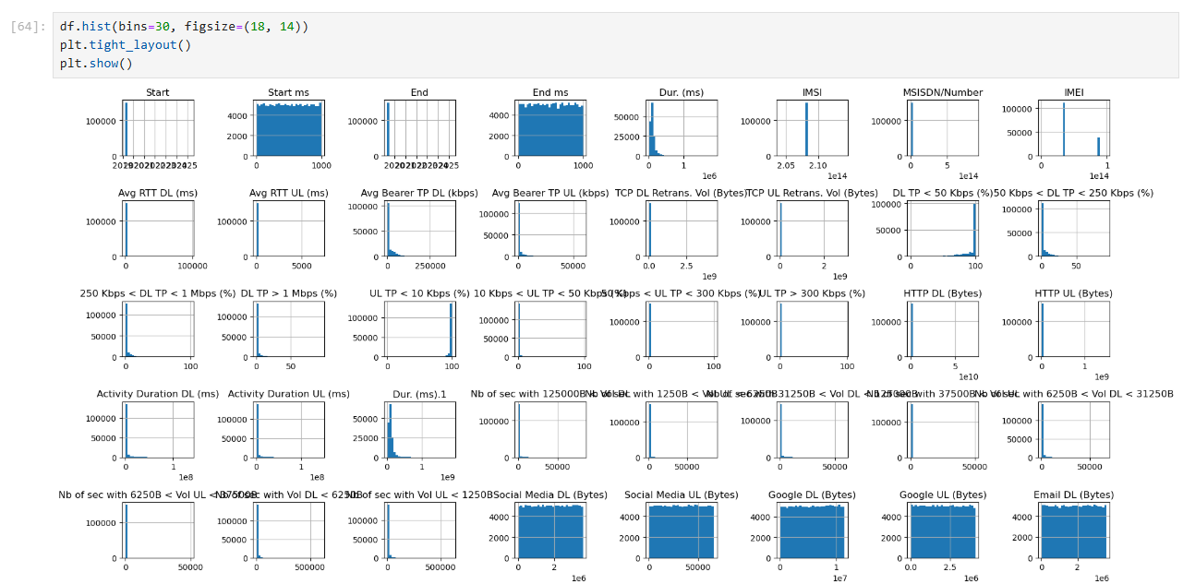
Graphical Univariant Analysis

Slide 14
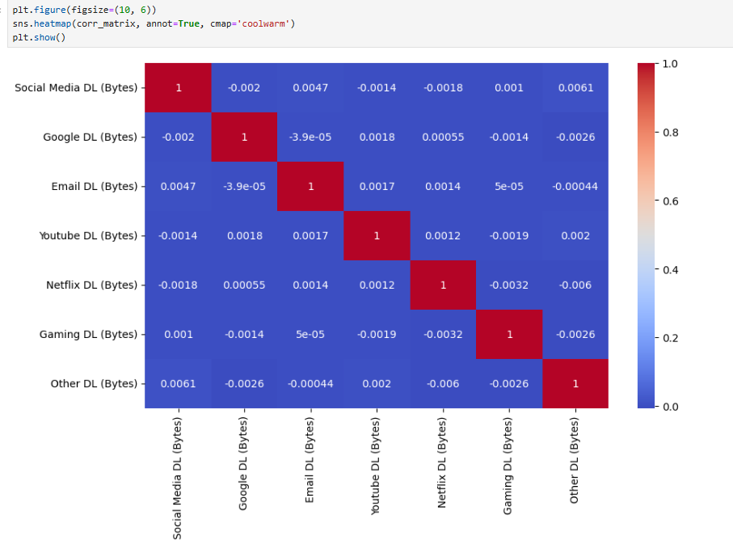
Correlation Analysis

Slide 15
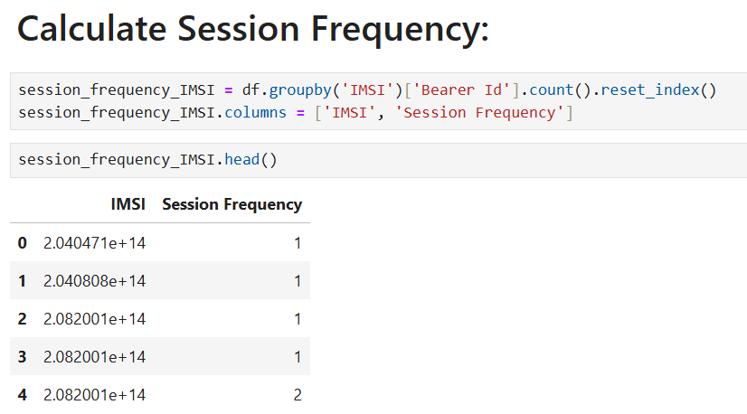
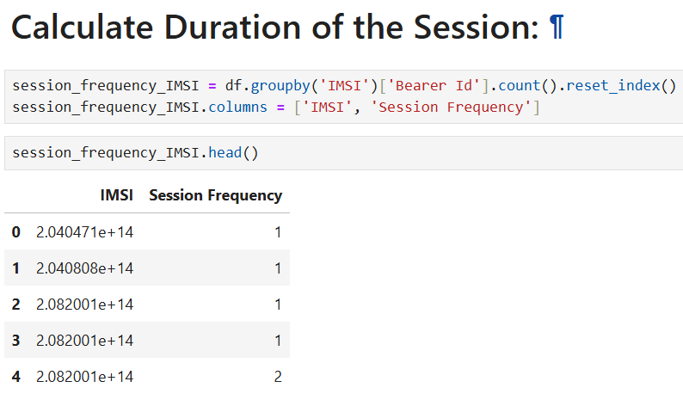
Task 2 - User Engagement Analysis

Slide 16
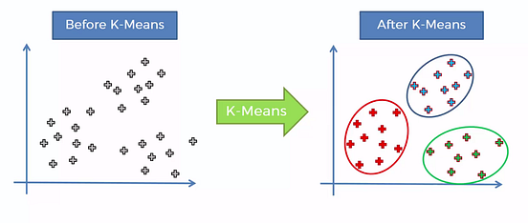
K-MEANS CLUSTERING
Understanding K-means Clustering
K-means clustering algorithm computes the centroids and iterates until we it finds optimal centroid. It assumes that the number of clusters are already known. It is also called flat clustering algorithm. The number of clusters identified from data by algorithm is represented by 'K' in K-means.

Slide 17
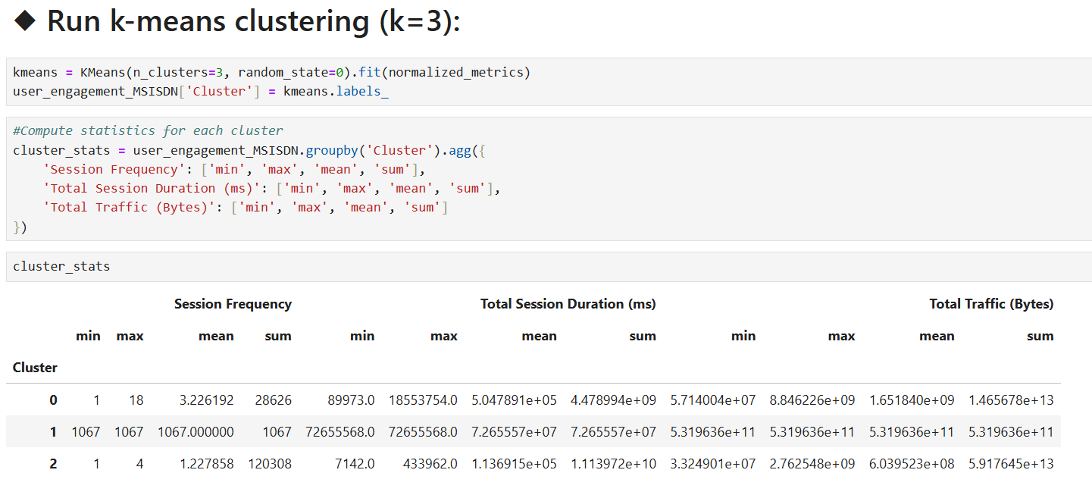
Visualization of k-means clustering

Slide 18
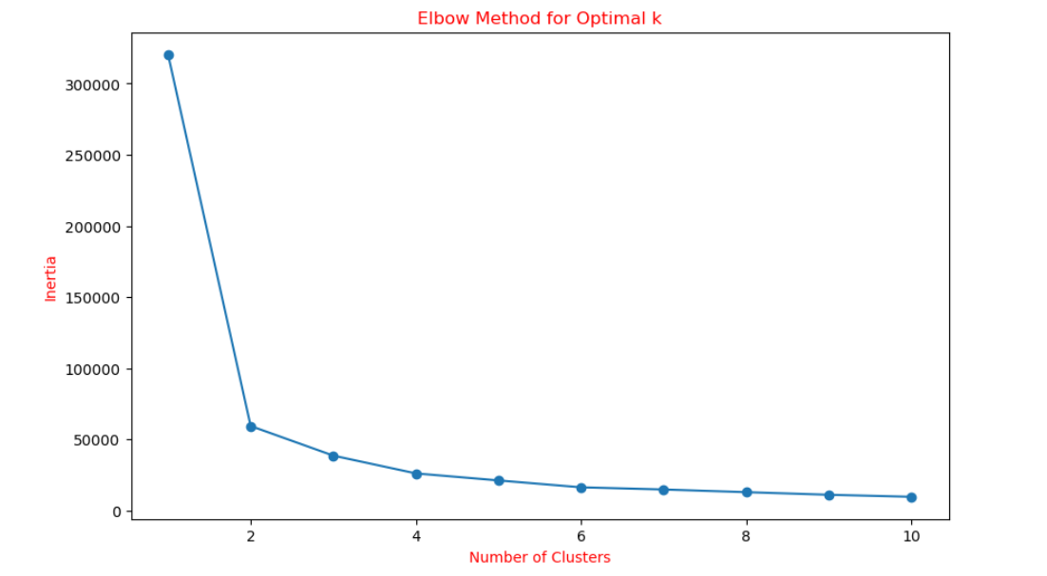
ELBOW METHOD
The Elbow Method is a visual approach used to determine the ideal ‘K’ (number of clusters) in K-means clustering. It operates by calculating the Within-Cluster Sum of Squares (WCSS), which is the total of the squared distances between data points and their cluster center. However, there is a point where increasing K no longer leads to a significant decrease in WCSS, and the rate of decrease slows down. This point is often referred to as the elbow.

Slide 19
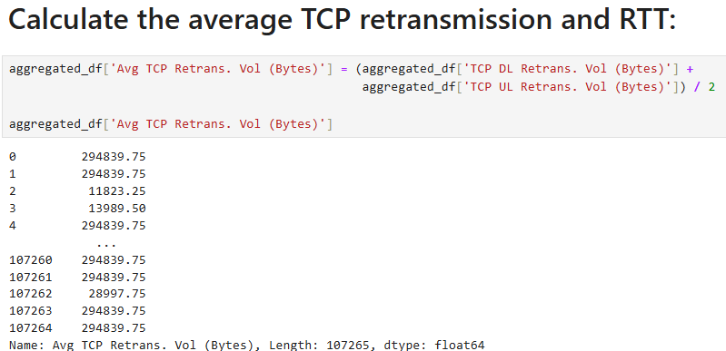
Task 3 - Experience Analytics
The Telecommunication industry has experienced a great revolution in the last decade. Mobile devices have become the new fashion trend and play a vital role in everyone's life. The success of the mobile industry is largely dependent on its consumers. Therefore, the vendors must focus on their target audience i.e. what are the needs and requirements of their consumers and how they feel and perceive their products. Tracking & evaluating customers’ experience can help organizations optimize their products and services so that they meet evolving user expectations, needs, and acceptance.

Slide 20
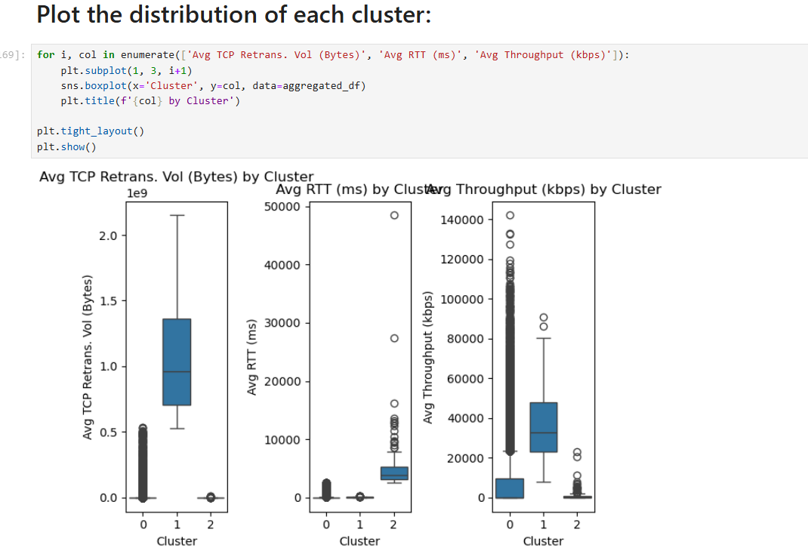

Slide 21
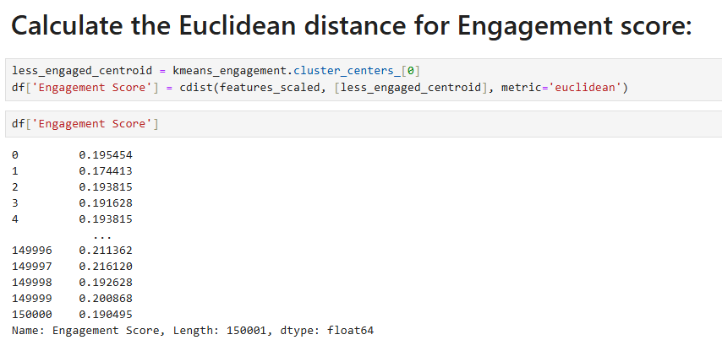
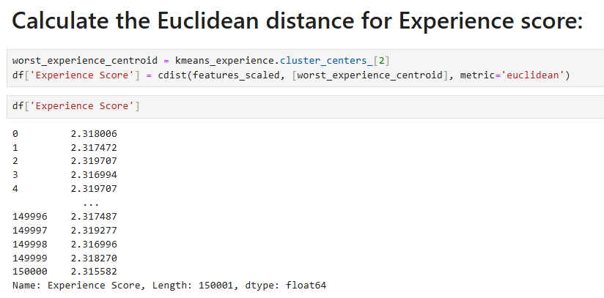
Task 4 - Satisfaction Analysis
Assuming that the satisfaction of a user is dependent on user engagement and experience, you’re expected in this section to analyze customer satisfaction in depth.
Perform Euclidean Distance

Slide 22
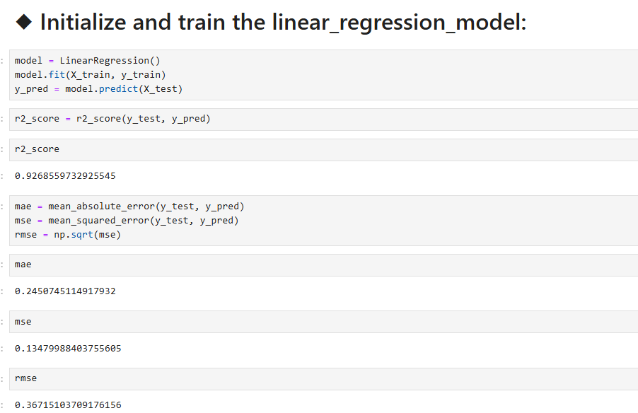
Initialize the Linear-regression-model

Slide 23
.
CONCLUSION !
After conducting an extensive analysis of Telecom user data, we have identified several key insights and opportunities for growth: User Overview: The top 10 handsets and top 3 manufacturers dominate the market. Marketing strategies should target these popular devices to maximize reach. The aggregated user behavior data highlights significant usage patterns across various applications, providing a clear picture of customer preferences. User Engagement: High engagement metrics were observed for users frequently accessing social media, YouTube, and Netflix. Enhancing network resources for these applications could improve user satisfaction and retention. K-means clustering revealed distinct user segments based on engagement levels, allowing for targeted marketing and resource allocation THIS IS BIG UNDERSTANDING TELECOME DATA FOR GROWTH KNOWLEDGE AND EXPERIENCE . THANKS FOR NEXT HIKES IT SOLUTION FOR GIVEN THIS PROJECT.

Slide 24
THANK YOU

